Slide 1


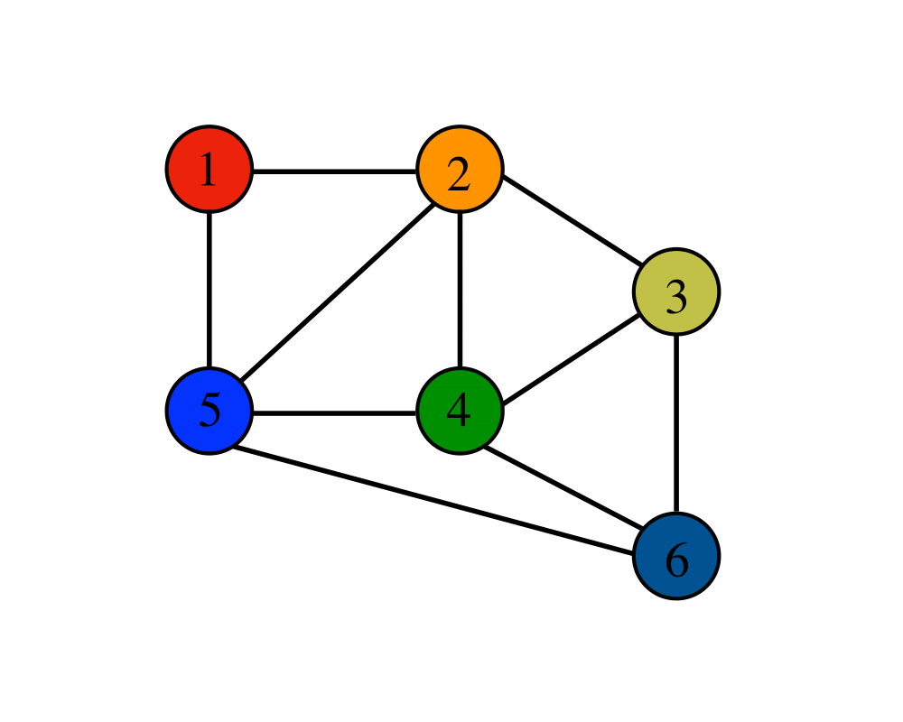

DATA STRUCTURE USED IN MAP
GRAPH DATA STRUCTURE
DIVISION : B
NAME | ROLL NO. | PRN
Niraj Mantri | 222039 | 22010928
Rushikesh Mantri | 222040 | 22010703
MANYA GUPTA | 222041 | 22010316
ABHISHEK MASALI | 222042 | 22010301
Suraj Meshram | 222043 | 22010815

Slide 2
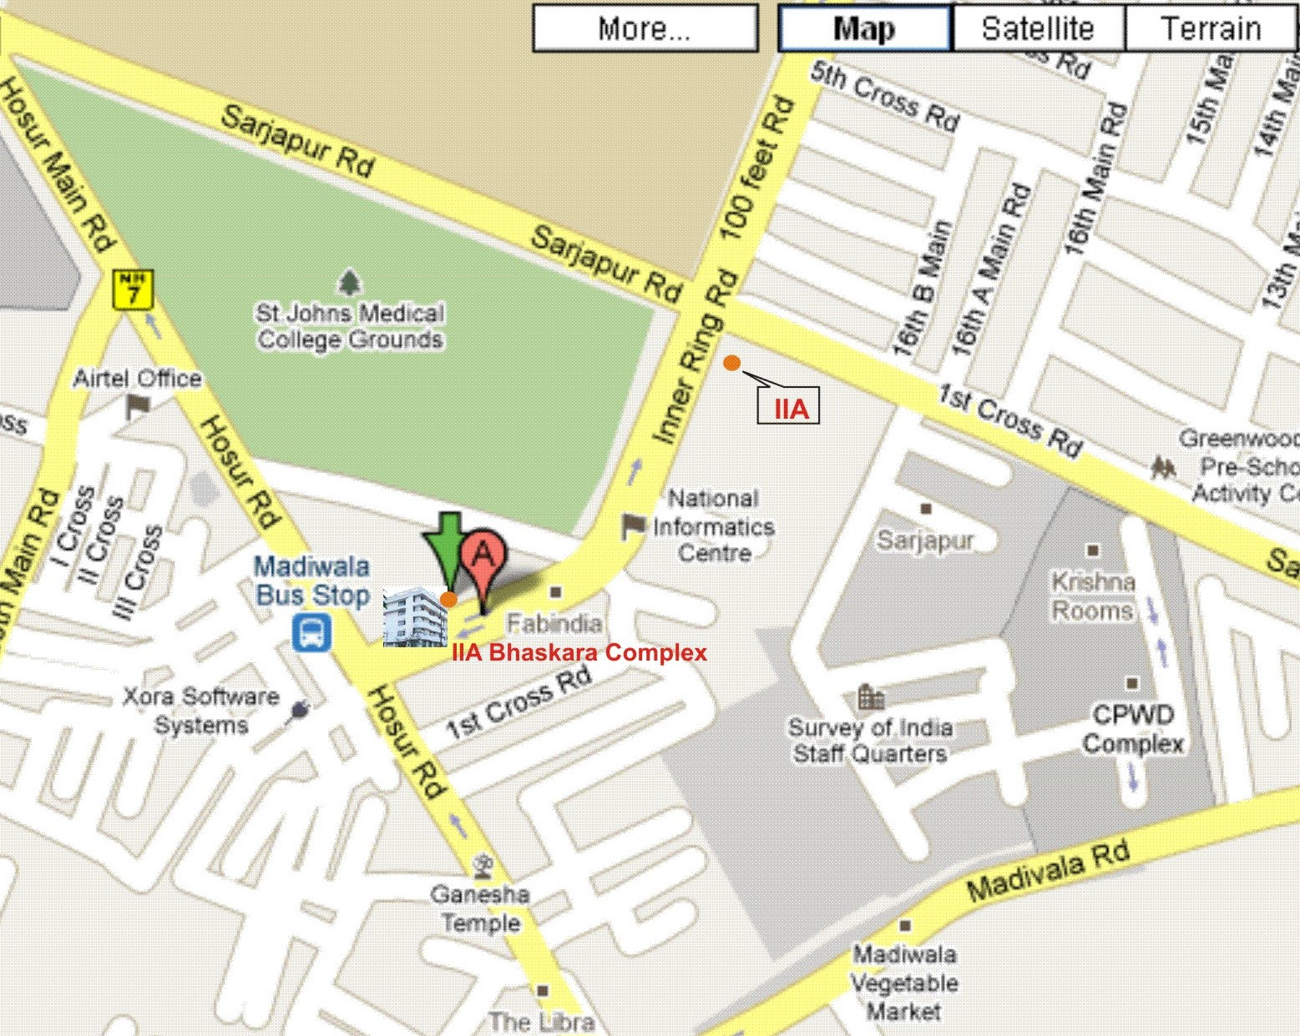

GOOGLE MAPS
DATA STRUCTURE AND ALGORITHM?

Slide 3



ANSWER: GRAPH DATA STRUCTURE
GRAPHS ARE USED TO REPRESENT, FIND, ANALYSE AND OPTIMIZE CONNECTIONS BETWEEN ELEMENTS.
VERTICES |V|= 5
EDGES |E| = 7

Slide 4
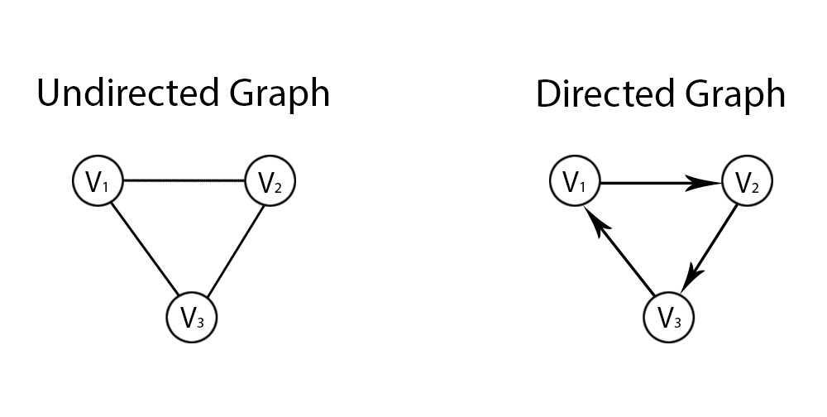
GRAPH
DIRECTED GRAPHS
UNDIRECTED GRAPH
EDGES HAVE A DIRECTION AND THERE IS NO WAY TO RETURN TO THE INITIAL NODE THROUGH THAT EDGE
EDGES ARE UNDIRECTED AND CAN GO FROM ONE NODE TO ANOTHER AND RETURN THROUGH THE SAME POINT.

Slide 5
ALGORITHM : DIJKSTRA’S ALGORITHM
(SINGLE SOURCE SHORTEST PATH)
RELAXATION
if d(u) + c(u,v) < d(v)
d(v) = d(u) + c(u,v)
1) Create a set sptSet (shortest path tree set) that keeps track of vertices included in the shortest-path tree.
2) Minimum distance from the source is calculated and finalized.
3) Initially, this set is empty. 4) Assign a distance value to all vertices in the input graph. Initialize all distance values as INFINITE. Assign distance value as 0 for the source vertex so that it is picked first.

Slide 6
Continue….
3) While sptSet doesn’t include all vertices a) Pick a vertex u which is not there in sptSet and has a minimum distance value. b) Include u to sptSet. c) Update distance value of all adjacent vertices of u.
d)To update the distance values, iterate through all adjacent vertices.
e)For every adjacent vertex v, if the sum of distance value of u (from source) and weight of edge u-v, is less than the distance value of v, then update the distance value of v.

Slide 7
Djikstra's algorithm Pseudocode
function dijkstra(G, S) for each vertex V in G distance[V] <- infinite previous[V] <- NULL If V != S, add V to Priority Queue Q distance[S] <- 0 while Q IS NOT EMPTY U <- Extract MIN from Q for each unvisited neighbour V of U tempDistance <- distance[U] + edge_weight(U, V) if tempDistance < distance[V] distance[V] <- tempDistance previous[V] <- U return distance[], previous[]

Slide 8
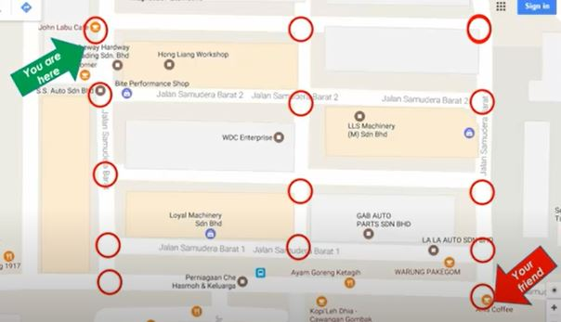
APPLICATION OF GRAPH THEORY IN GOOGLE MAPS

Slide 9
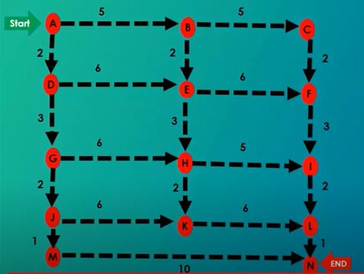

Slide 10
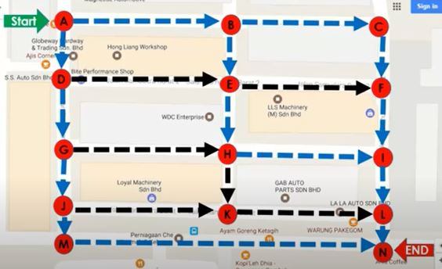

Slide 11
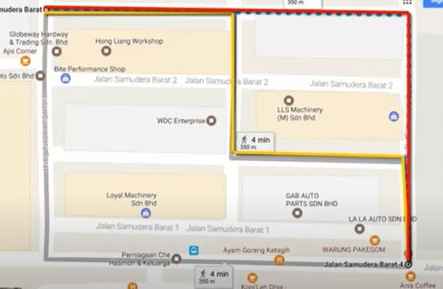

Slide 12
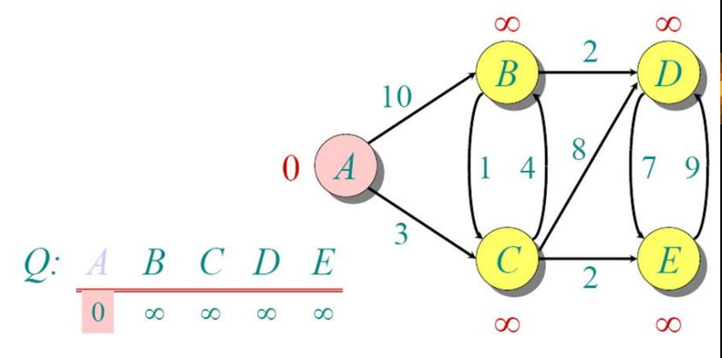
Example
Pick vertex not in S with lowest cost (F) and update neighbors

Slide 13
Thank You !

